Slide 1
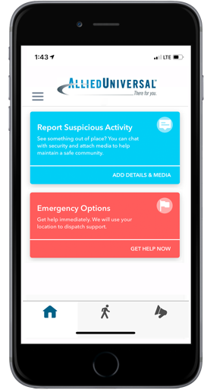
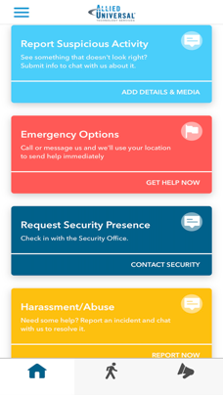
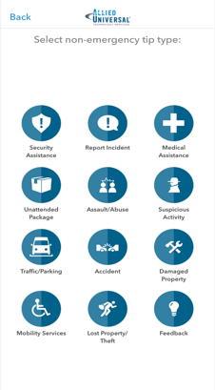
Intro to LiveSafe
Allied Universal has partnered with LiveSafe to offer a powerful risk reporting and two-way safety communications platform that integrates with HELIAUS
What is LiveSafe?
LiveSafe is a mobile risk intelligence and two-way safety communications app that enables your employees to quickly submit tips directly to security and improves our ability to communicate important safety and security information to your organization on a real-time basis.
How Does It Work?
Users report safety and security incidents using their mobile device, which is automatically routed to security personnel so they can respond appropriately.
Why Should I Use LiveSafe?
LiveSafe can help reduce the monetary and non-monetary costs of safety and security incidents, and make your organization a safer place to work, learn, and live.

